Slide 1
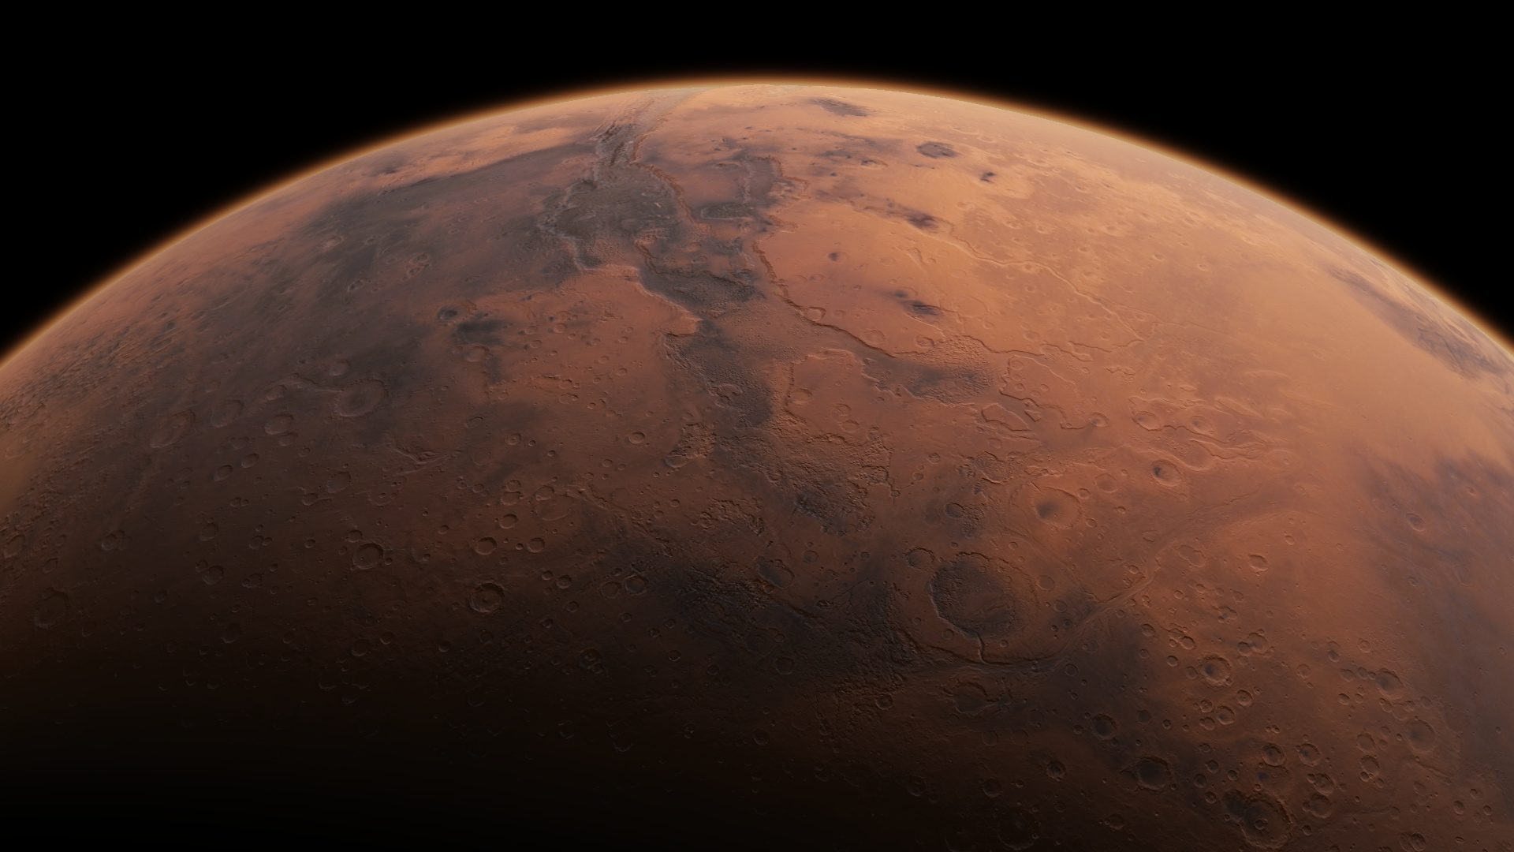



Hydrated Chlorine Salts on Mars
By: Zeke Bandelier
Mentors: Dr. Jennifer Hanley

Slide 2
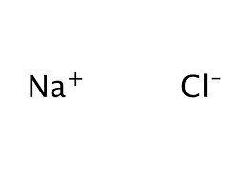
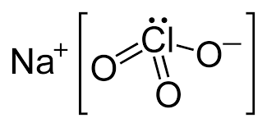
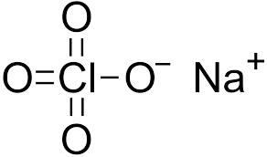

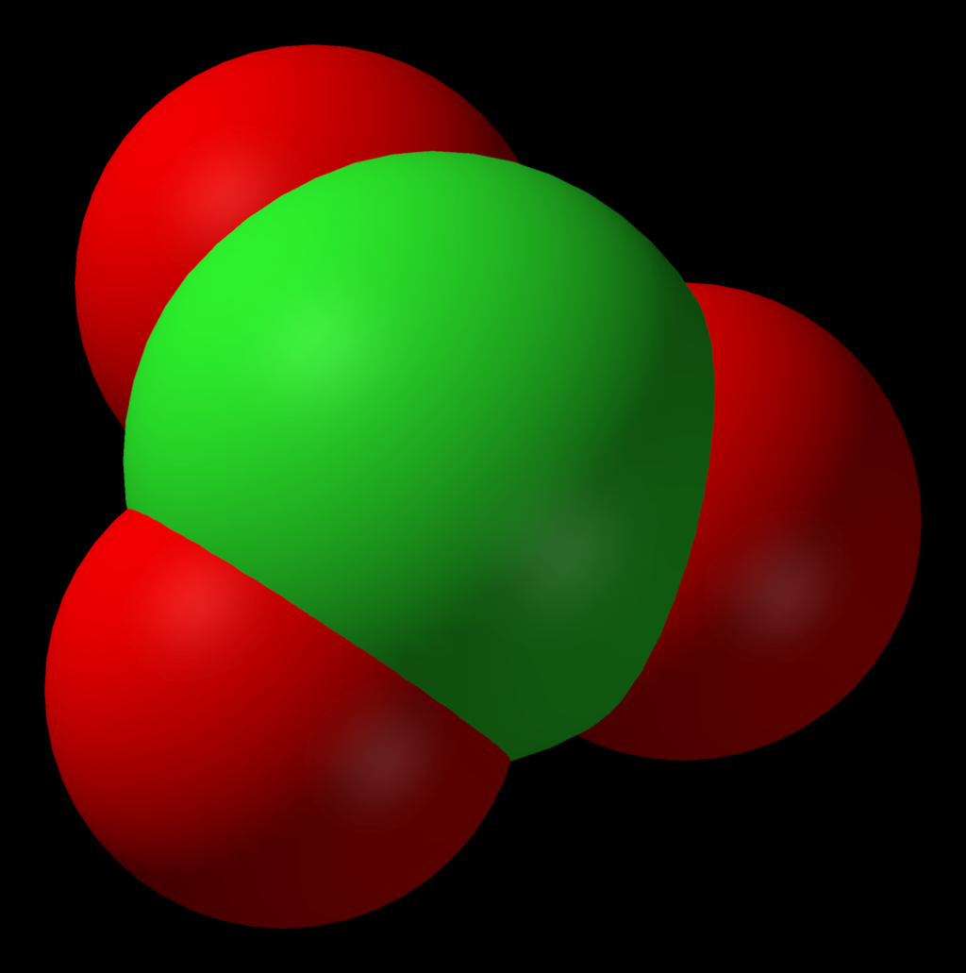
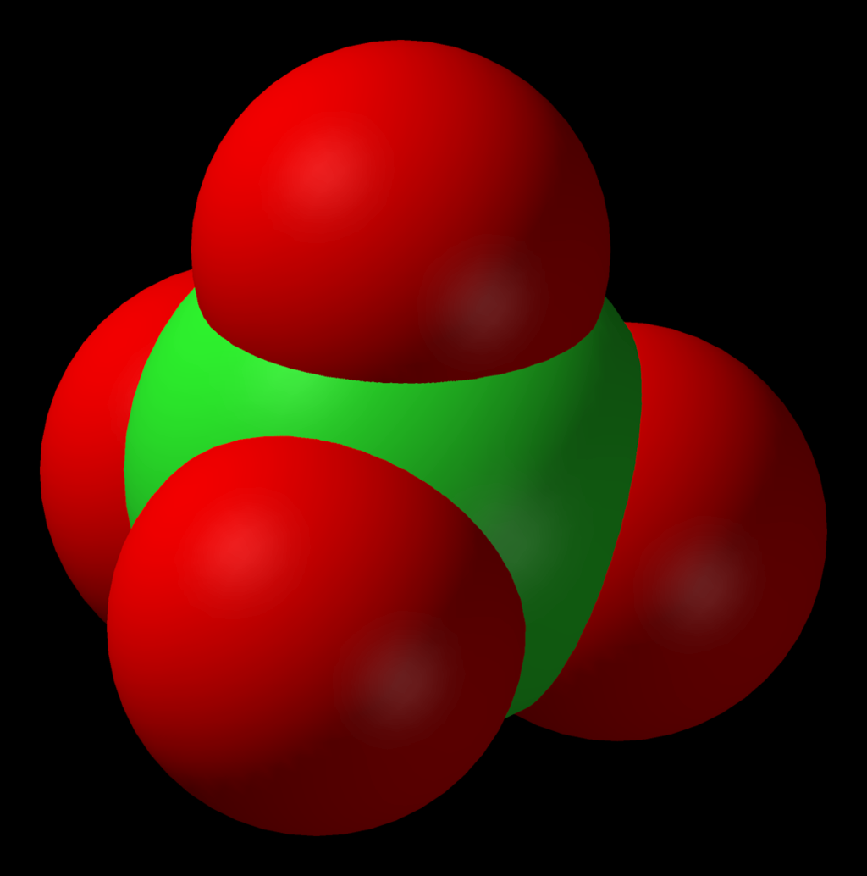
Introduction
Salts can depress the freezing point of water
270 K (Mg sulfate) vs 204 K (Mg chlorate)
Water’s normal freezing point: 273 K
Average Martian temperature: 210 K
Salts can become hydrated - Water has become integral part of the crystal
Other hydrated salts, such as sulfates, have already been detected on Mars
Chloride
Chlorate
Perchlorate

Slide 3
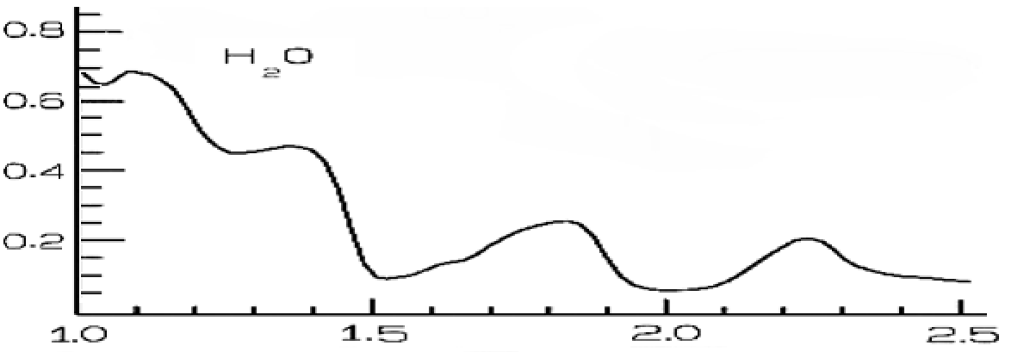
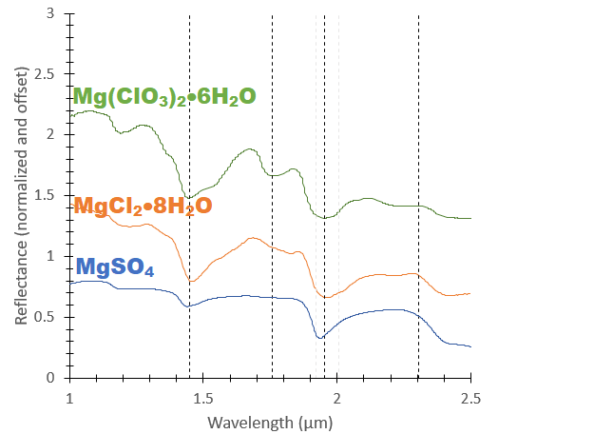
Spectra of Hydrated Salts
Hydrated sulfates and chlorine salts have similar absorption features: 1.4, 1.75, 1.9, and 2.4 μm
Large features are mainly due to water

Slide 4
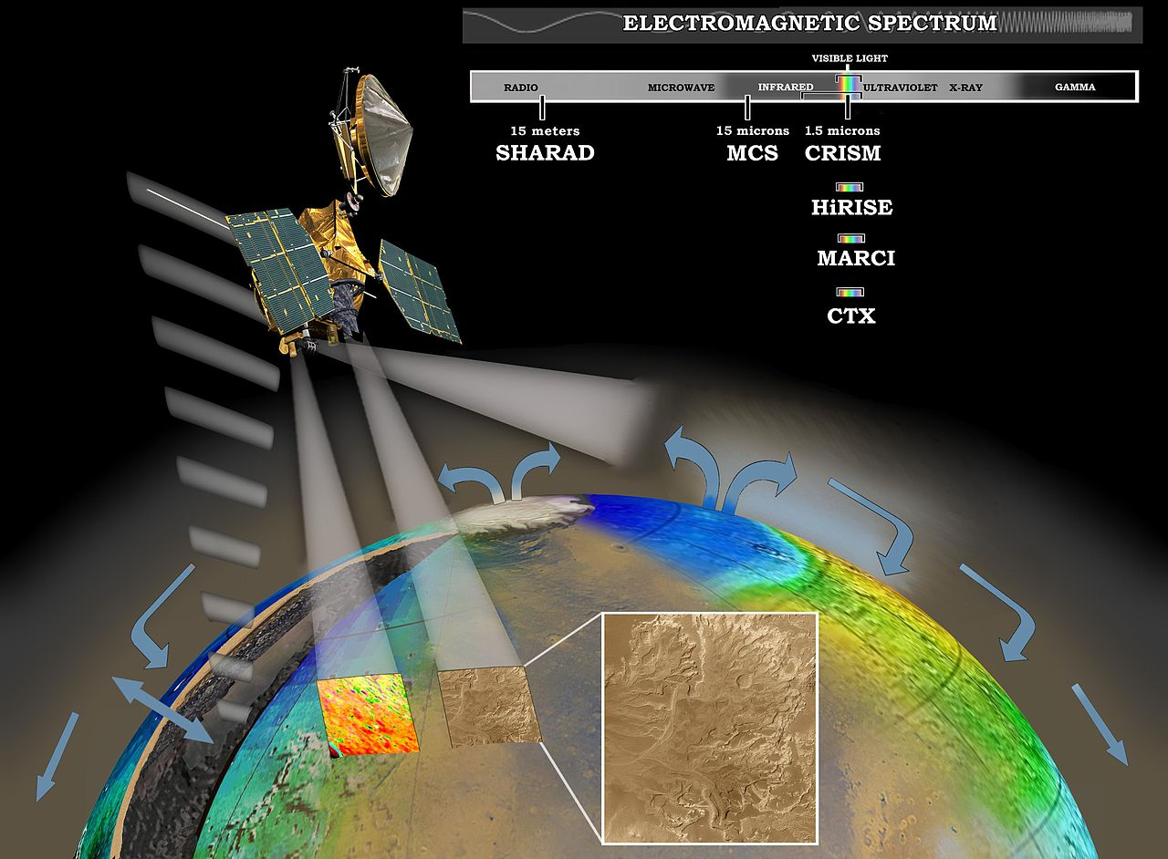
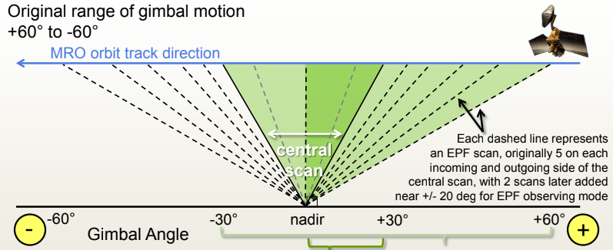
CRISM
Compact Reconnaissance Imaging Spectrometer for Mars
An instrument onboard the Mars Reconnaissance Orbiter
A gimbaled, visible-near infrared reflectance spectrometer
0.4-3.9 µm spectrometer
18 m/pixel resolution

Slide 5
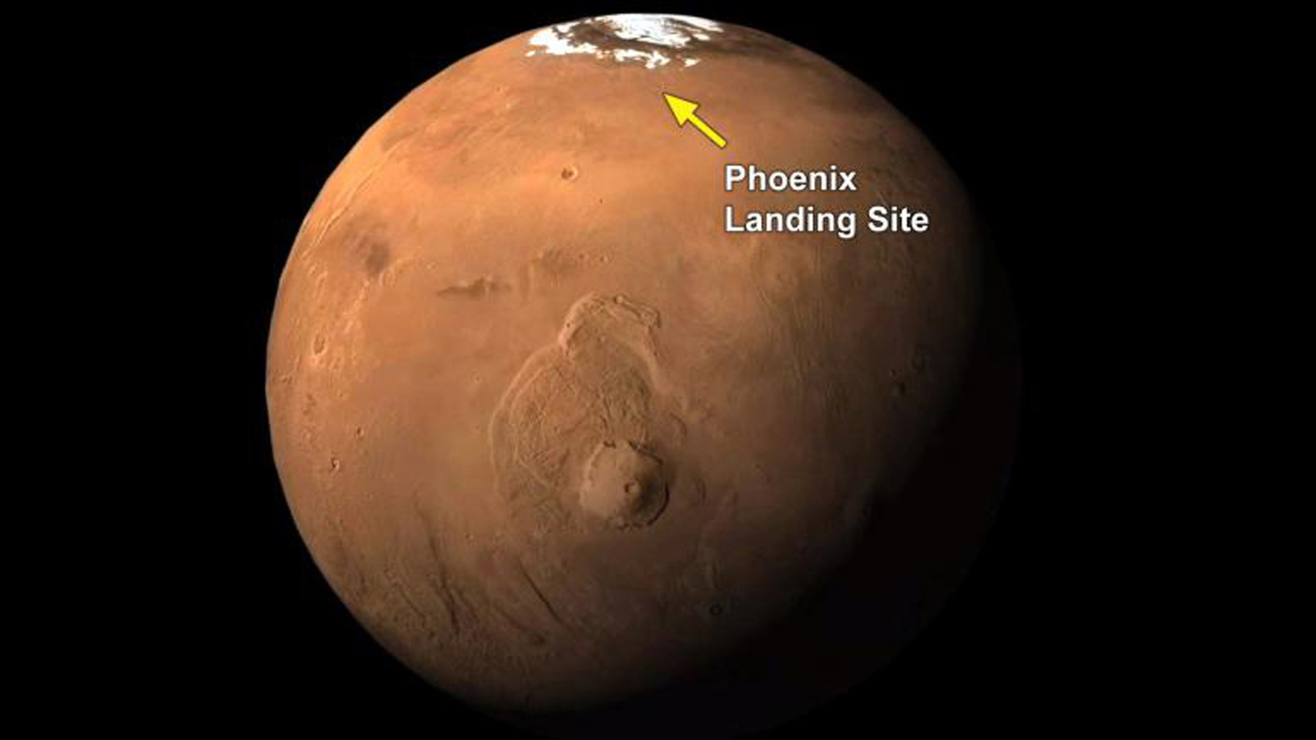
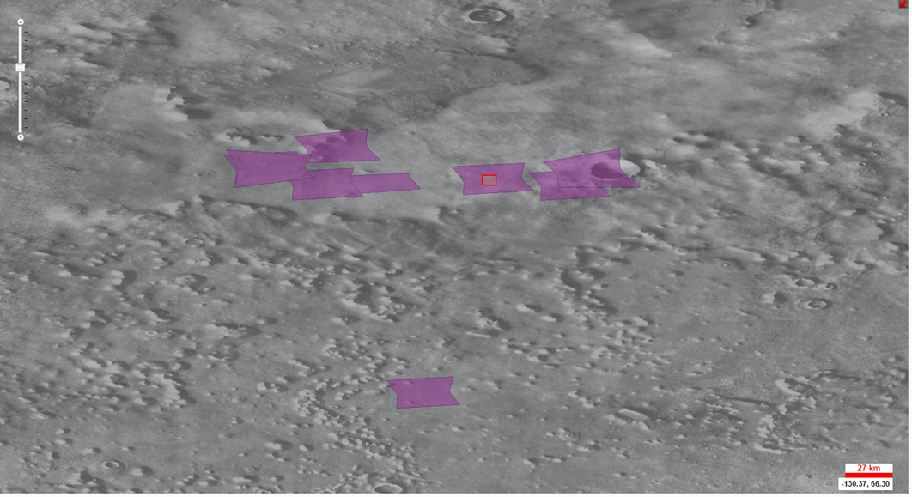
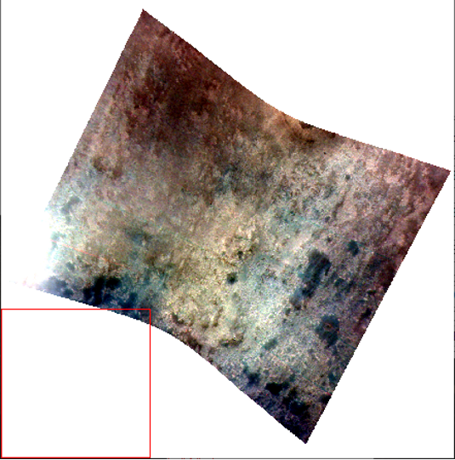
Primary Search Area
Phoenix lander and surrounding areas
65-70°N and 230-240°E
Images taken during summer months
6,169 different images
Chlorine salts have been detected in situ
Phoenix Lander Site

Slide 6
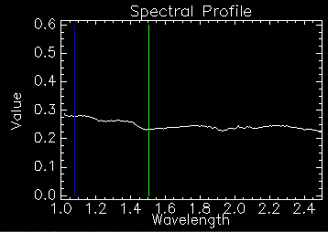
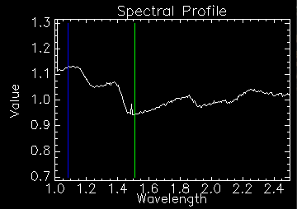
Ratioing Images
Each image has been photometrically and atmospherically corrected for prior to processing
Manual and automated code processes employed for ratioing (background removal)
Manual
  Select blank looking regions based on desired parameters to ratio out
Automatic
  Selects the most neutral pixel from the column and divides every other pixel by it
Done to remove noise and amplify spectra features
Images are column dependent
Before Ratioing
After Ratioing

Slide 7
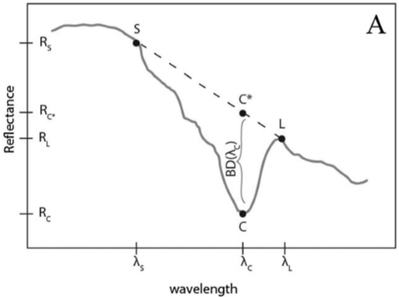
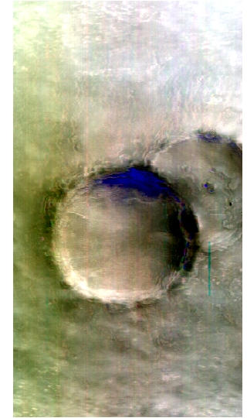
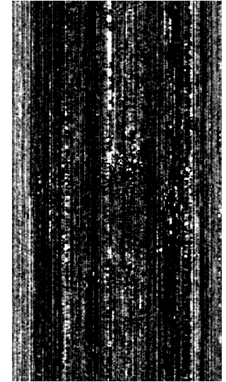
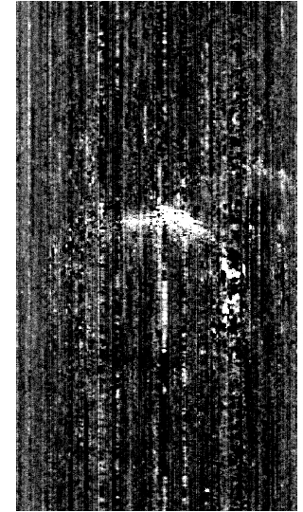
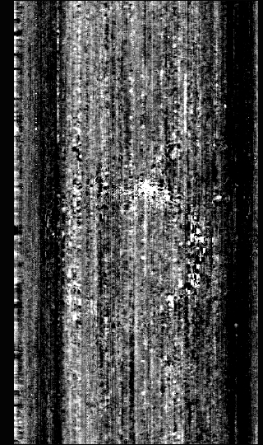
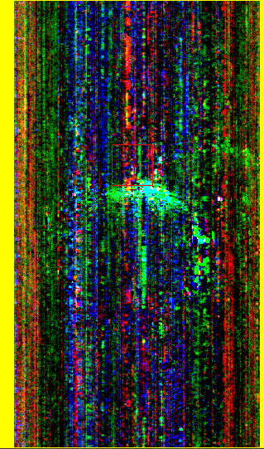
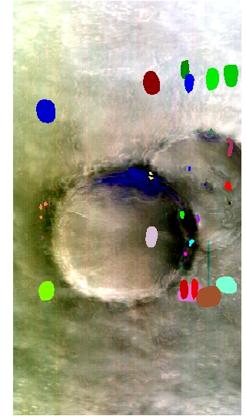
Parameters and Browse Products
Each pixel has an associated IR spectra
Band parameters output a measured value from the spectra
The browse product is an RGB combination of band parameters
Regions of interest can be created on the RGB combinations
R
G
B
Default RGB
BD1435
SINDEX_2
BD2130
RGB combination
Regions of Interest

Slide 8
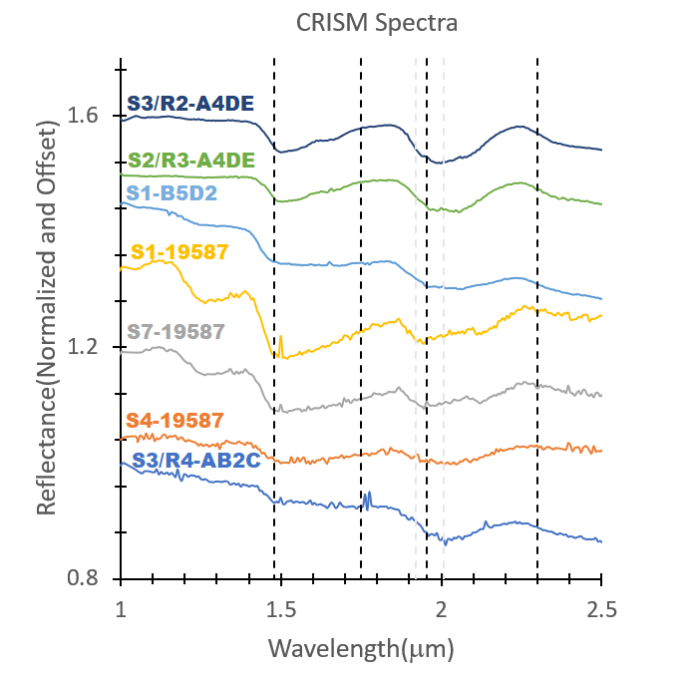
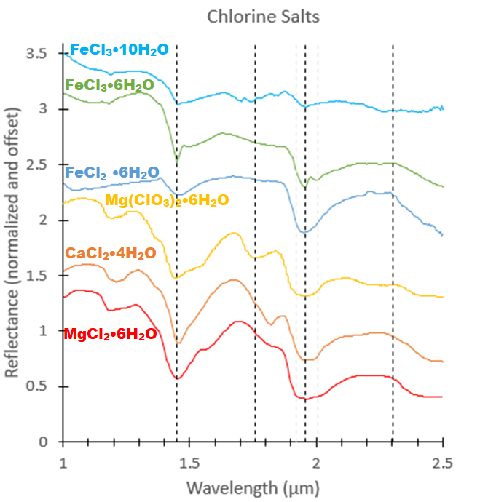

Slide 9
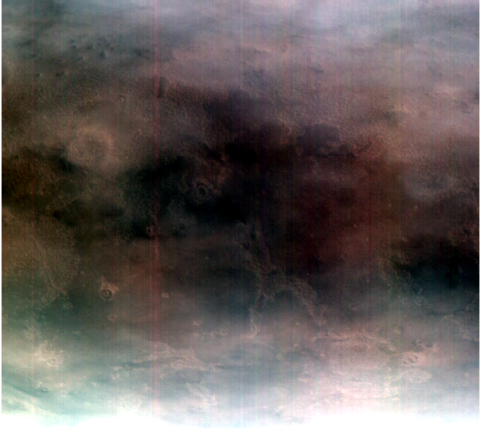
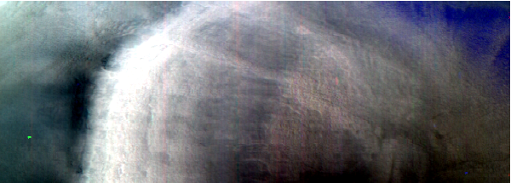
Summary
Interesting spectra were taken using new techniques
Water ice was detected in CRISM during summer months
Water ice is absent from the surface during summer

Slide 10
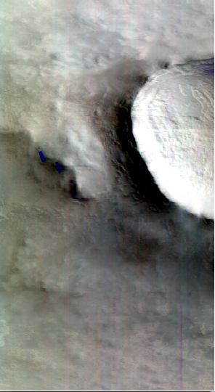
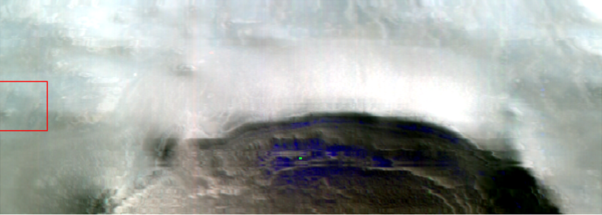
Future Work
Further analysis of interesting spectra to determine salt and/or water ice content
Possible implementation of water ice detection in upper regolith layer
Search for chlorine salts at other landing sites

Slide 11
Acknowledgements
Thank you to all the programs for making my research possible
NAU NASA Space Grant
Jennifer Hanley
Briony Horgan
Colin Murphy
Ari Koeppel

